Slide 1
Food Chains in Germany
An overview with data

Slide 2
Introduction
Question: Which German Cities have Which Restaurants?

Slide 3
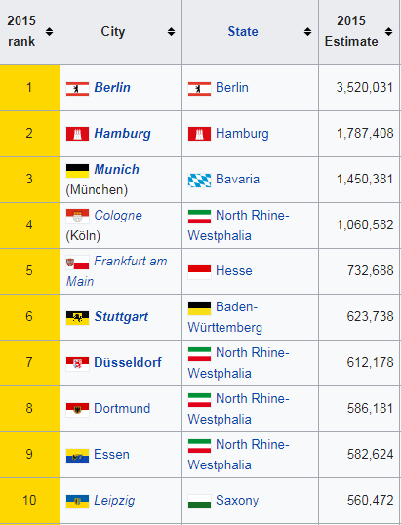
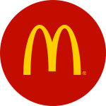
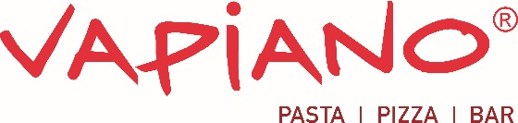
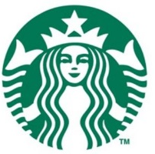

Top Cities and 4 Restaurants

Slide 4
Gathering Data
The data is gathered from Foursquare’s Places API. Only the main cities will be taken into consideration, and the numbers will be taken from the results coming from the API.
Data is gathered with the following API:
GET https://api.foursquare.com/v2/venues/search
With the following Parameters:
search_query = Will change according to the food chain considered
near = Will change for the city
radius = will be constant, 10000
intent= 'browse'

Slide 5
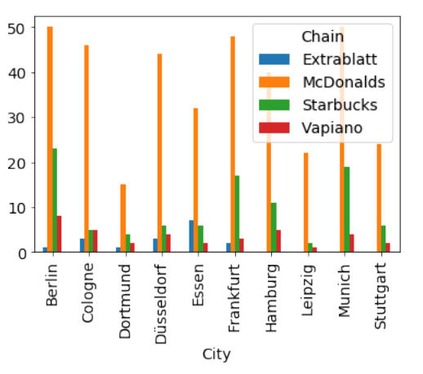
Results

Slide 6
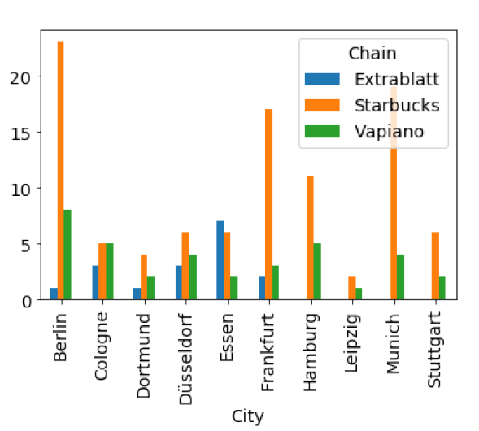
Results (cont’d)

Slide 7
Results (cont’d)

Slide 8
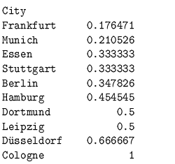
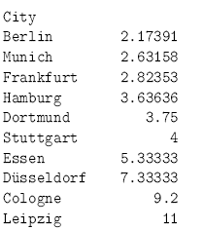
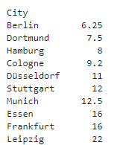
Results
Vapiano vs Startbucks
McDonalds vs Starbucks
McDonalds vs Vapiano

Slide 9
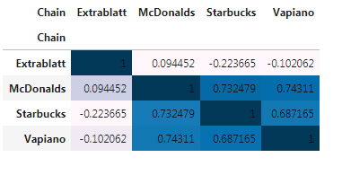
Results
Correlation Index

Slide 10
Discussion
Highly Homogeneous Market except Extrablatt
Startbucks and McDonalds well penetrated
Vapiano is still developing

Slide 11
Conclusion
A lot of different data can be investigated when a new restaurant is going to be opened. Regarding Germany, the homogeneity of the country and well establishment of global chains should be taken into consideration.

